Slide 1
CS4487 Course Project
Group 18
Qiu Hanzheng (56642600)
Wu Zhiyou (56237274)
XU Rui (56200188)
Videos retrieved from https://nerf-w.github.io/

Slide 2
Outline
1. Methodologies
2. Related Works
3. Experiment
4. Future Works

Slide 3
Outline
1. Methodologies
2. Related Works
3. Experiment
4. Future Works

Slide 4
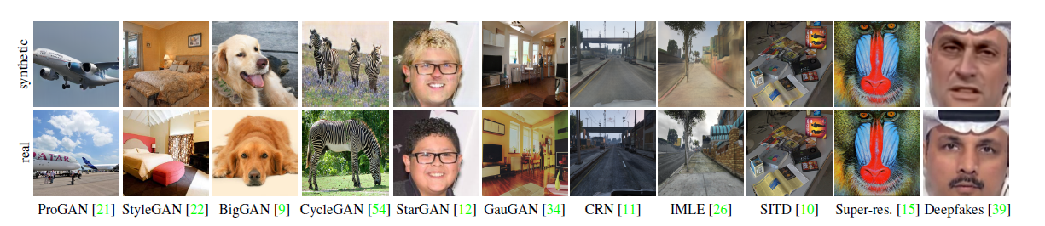
Methodologies
CNN-generated images are surprisingly easy to spot... for now (CVPR2020)
Aim: Detect fake images generated by different image generator models
(In our project, DeepFake generator models)
Finding: A standard image classifier trained on only one specific CNN generator (ProGAN) can generalize surprisingly well to other unseen architectures
Wang, S. Y., Wang, O., Zhang, R., Owens, A., & Efros, A. A. (2020). CNN-generated images are surprisingly easy to spot... for now. In Proceedings of the IEEE/CVF conference on computer vision and pattern recognition (pp. 8695-8704).

Slide 5
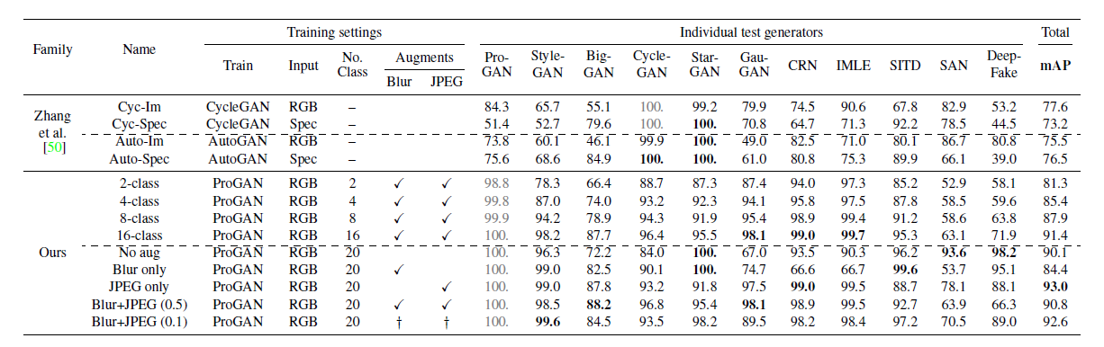
Methodologies
CNN-generated images are surprisingly easy to spot... for now (cont’d)
Method:
Use ProGAN-generated image as training set
A classifier based on ResNet-50 is trained to binary classify images
Experiment Result:
Wang, S. Y., Wang, O., Zhang, R., Owens, A., & Efros, A. A. (2020). CNN-generated images are surprisingly easy to spot... for now. In Proceedings of the IEEE/CVF conference on computer vision and pattern recognition (pp. 8695-8704).

Slide 6
Outline
1. Methodologies
2. Related Works
3. Experiment
4. Future Works

Slide 7
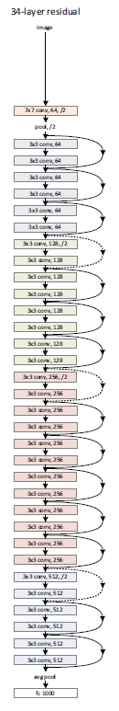
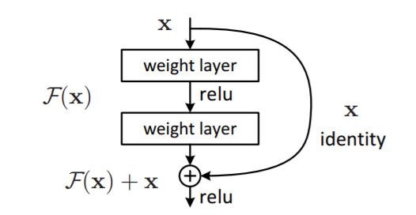
Related Works
ResNet
Alleviated “degradation” problem by residual learning
(adding shortcut connection)
He, K., Zhang, X., Ren, S., & Sun, J. (2016). Deep residual learning for image recognition. In Proceedings of the IEEE conference on computer vision and pattern recognition (pp. 770-778).

Slide 8
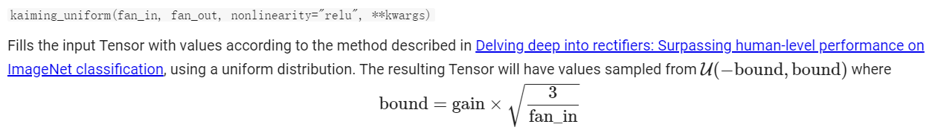
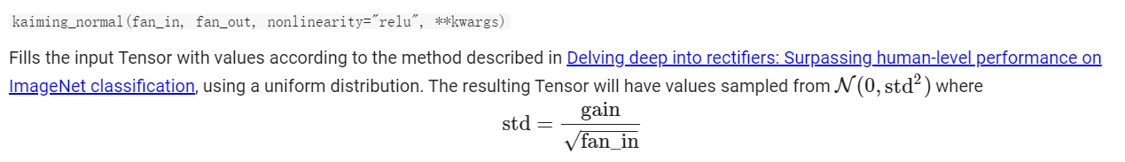
Related Works
Network Initialization
Random -> Xavier -> Kaiming
Settle the problems of vanishing gradient & fitting ReLU activation function
Reference: https://blog.csdn.net/VictoriaW/article/details/73166752, https://zhuanlan.zhihu.com/p/64464584, https://dlsyscourse.org/lectures/

Slide 9
Outline
1. Methodologies
2. Related Works
3. Experiment
4. Future Works

Slide 10
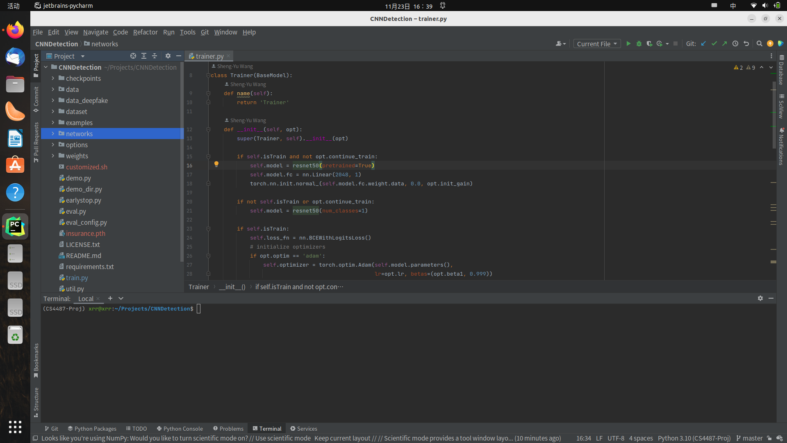
Experiment
Code Overview

Slide 11
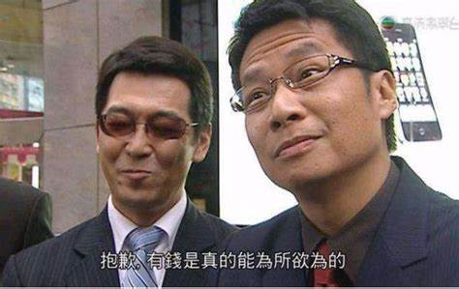
Experiment
Platform
Ubuntu 22.04 with GUI
NVIDIA GTX1650 (sorry, I am poor) (but our university is rich!)
Tools: PyCharm, Anaconda, Git

Slide 12
Experiment
Our project link
https://github.com/xrr-233/CS4487-Project
(public, with installation guide)

Slide 13
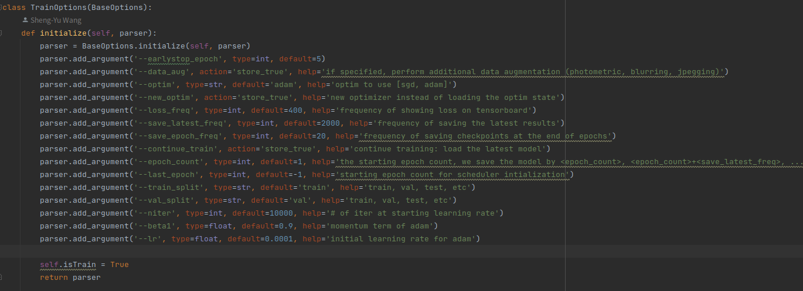
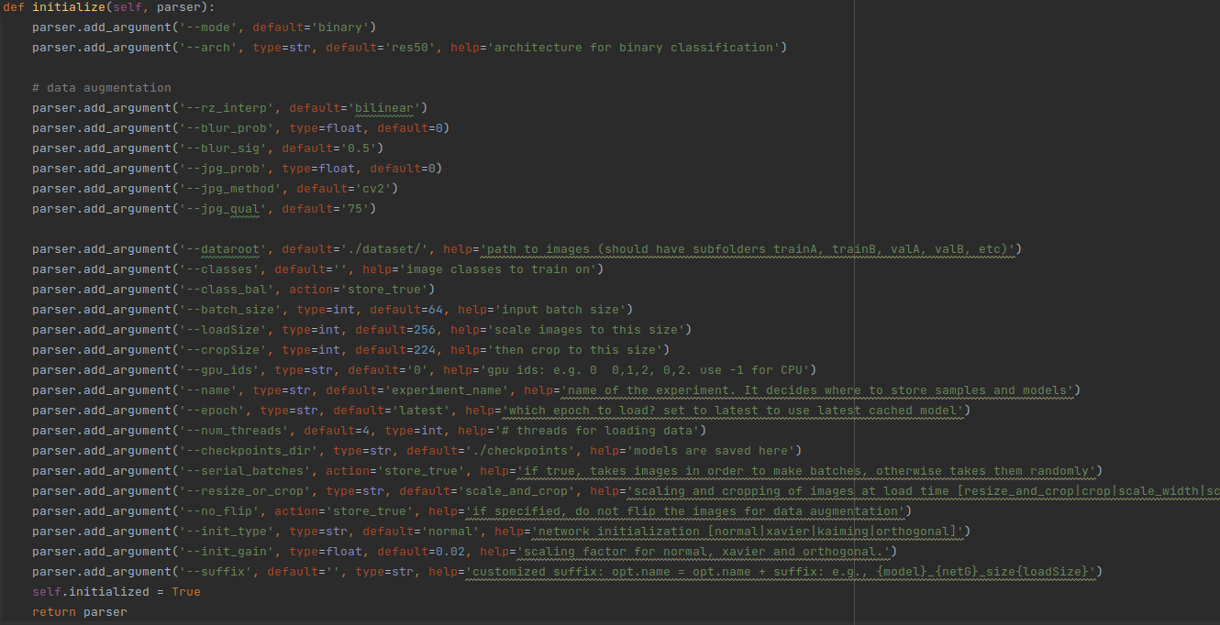
Experiment
Preliminary Training Parameters

Slide 14
Experiment
Preliminary Training Parameters (Unchanged)
Param Name | Default | Meaning
blur_prob | 0 | Blurring effect
jpeg_prob | 0 | JPEG compression
arch | ‘res50’ | Architecture for binary classification
load_size | 256 | First scale the data to this size
crop_size | 224 | Then crop to this size
resize_or_crop | ‘scale_and_crop’ | Actions when loading data
… | … | …

Slide 15
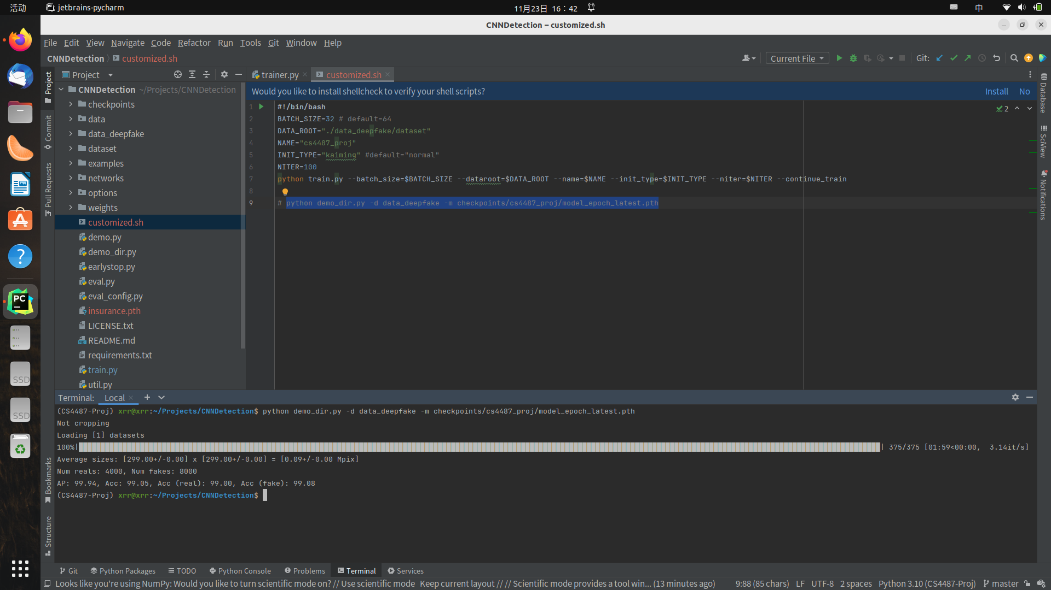
Experiment
Preliminary Training Parameters (Changed)
Param Name | Default | Actual | Meaning
batch_size | 64 | 32 | Size per batch for training
data_root | - | - | -
name | - | - | -
init_type | ‘normal’ | ‘kaiming’ | Weight Initialization Method
niter | 10000 | 100 | Epoch times

Slide 16
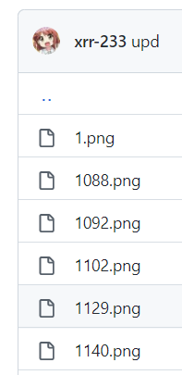
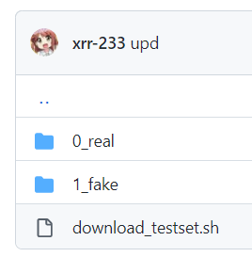
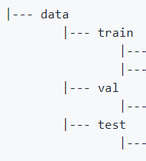
Experiment
Dataset
Not ProGAN stated in the paper, but DeepFake provided
Train : Valid : Test = 8:1:1
Shuffled Randomly (So, True : Fake in the train/valid/test set is not 1:2)

Slide 17
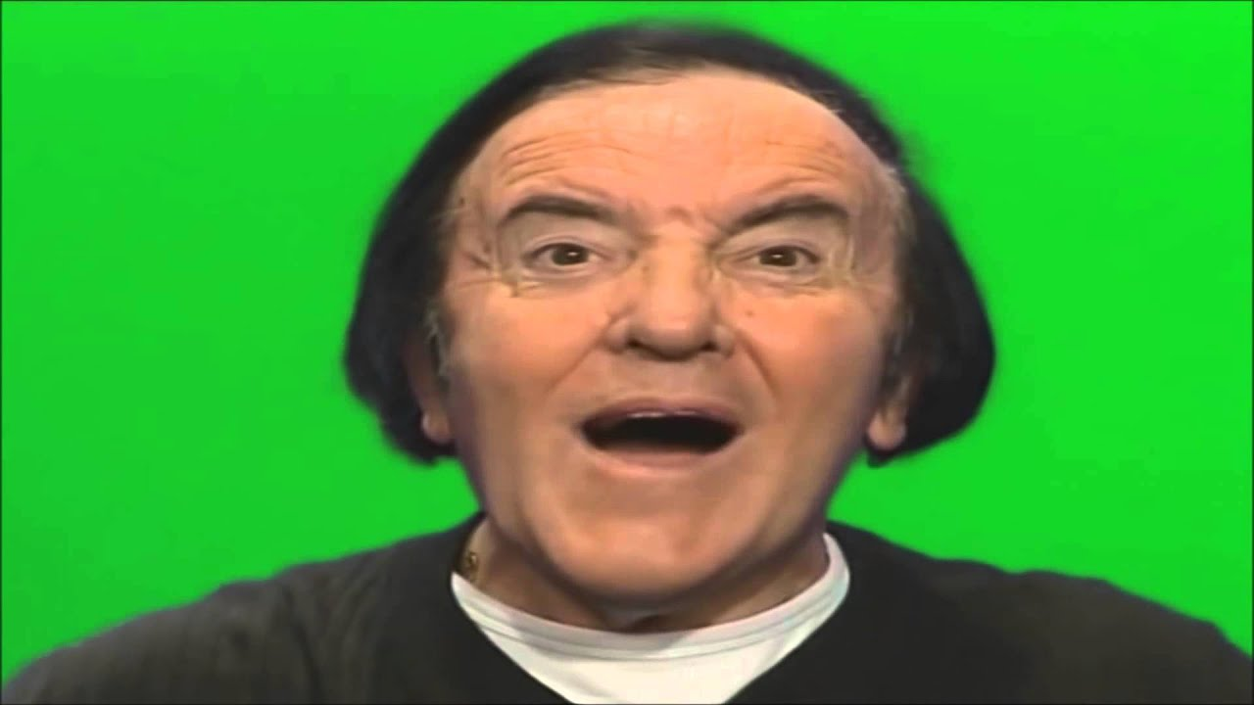
Experiment
Preliminary Result
Wow!

Slide 18
Outline
1. Methodologies
2. Related Works
3. Experiment
4. Future Works

Slide 19
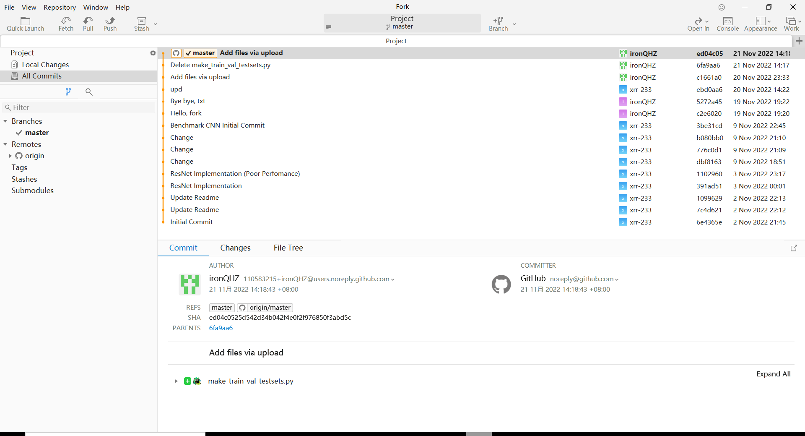
Future Works
TODO
Train with other parameter settings
Work out a comprehensive “.ipynb” file
Multi-class approaches (just like the previous groups stated)

Slide 20

Future Works
Acknowledgement
Dr. MA
And his TAs
And the colleagues who shared relevant & valuable information

Slide 21
Thank you!

